Slide 1

ChatTwo
Building a chat program

Slide 2
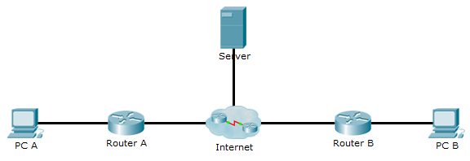
Network Diagram
LoginReply
Login
PC A’s list:
Server’s address
Server’s list:
Server’s list:
PC A’s address
PC B’s list:
Server’s address
Notes:
PC A and PC B have the Server’s addess
PC A send Login message to Server
Server now have PC A’s address
Server send LoginReply message to PC A

Slide 3
Network Diagram
LoginReply
Login
PC A’s list:
Server’s address
Server’s list:
PC A’s address
PC B’s address
Server’s list:
PC A’s address
PC B’s list:
Server’s address
Notes:
PC B send Login message to Server
Server now have PC B’s address
Server send LoginReply message to PC B

Slide 4
Network Diagram
Status
Status
PC A’s list:
Server’s address
Server’s list:
PC A’s address
PC B’s address
PC B’s list:
Server’s address
Notes:
PC A send Status message to Server every 500 milliseconds
PC B send Status message to Server every 500 milliseconds
This ensure the addresses are up to date
This also functions as “keepalive”
Keeping the NAT routers open for server messages

Slide 5
Network Diagram
ContactStatus
PC A’s List:
Server’s Address
Server’s list:
PC A’s address
PC B’s address
PC B’s list:
Server’s address
PC A’s list:
Server’s address
PC B’s address
PC B’s list:
Server’s address
PC A’s address
Notes:
Server send ContactStatus message to PC A
Server send ContactStatus message to PC B
This happen whenever PC A or PC B either logon or logoff
If they have each other as contacts of course

Slide 6
Network Diagram
Message
Message
PC A’s list:
Server’s address
PC B’s address
Server’s list:
PC A’s address
PC B’s address
PC B’s list:
Server’s address
PC A’s address
Notes:
PC A send a Message message to PC B
PC B send a Message message to PC A
They can get through the NAT routers thanks to the Status keepalive messages

Slide 7
MAC – Creation
Message
Timez
+
Timez
Message
SharedSecret
Hash
+
Message Hash
+
MAC
Timez
Message
SharedSecret
Message Hash
Hash
MAC
Notes:
Add in Timez
Timez used to make it more unique
Creditcard example
Concatenate Timez with Message
Hash the Timez+Message
Add SharedSecret
Concatenate SharedSecret with MessageHash
Hash the SharedSecret+MessageHash
Concatenate MAC with Timez+Message

Slide 8
MAC – Validation
MAC
Timez
Message
-
Timez
Message
MAC
SharedSecret
Hash
+
Message Hash
Identical?
SharedSecret
Message Hash
Hash
MAC
Notes:
De-concatenate MAC from Timez+Message
Create a MAC from the Timez+Message
Compare the received MAC with the created MAC
No encryption

Slide 9
Database – Contacts table
ID_1 | ID_2 | 1To2 | 2To1
Notes:
The users appear
Purple add Green
Green add Purple
Red add Green
Purple and Red add each other
Purple remove Red
Red remove Green

Slide 10
Database – Contacts table
ID_1 | ID_2 | 1To2 | 2To1
Notes:
The users appear
Purple add Green
Green add Purple
Red add Green
Purple and Red add each other
Purple remove Red
Red remove Green
The entry is removed

Slide 11
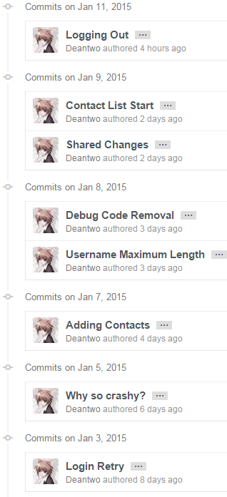
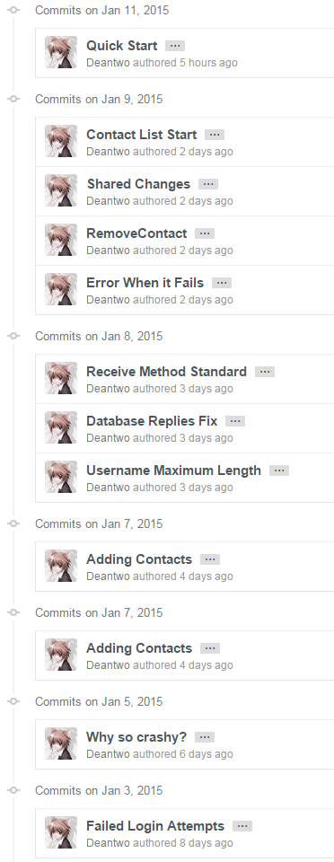
Progress

